Slide 1
IT Intern Project Overview: Oracle Xstore Error Logs Analysis
--Lingyin Wu, Interconnected Retail
Manager : Louis Lionetti

Slide 2

About Me
Lingyin Wu
Rice University, Houston, TX
Computer Science major, Statistics minor
I like coding, philosophy, hiking, meditation, music composition …
I am interested in data science and hope to work in data science field.

Slide 3
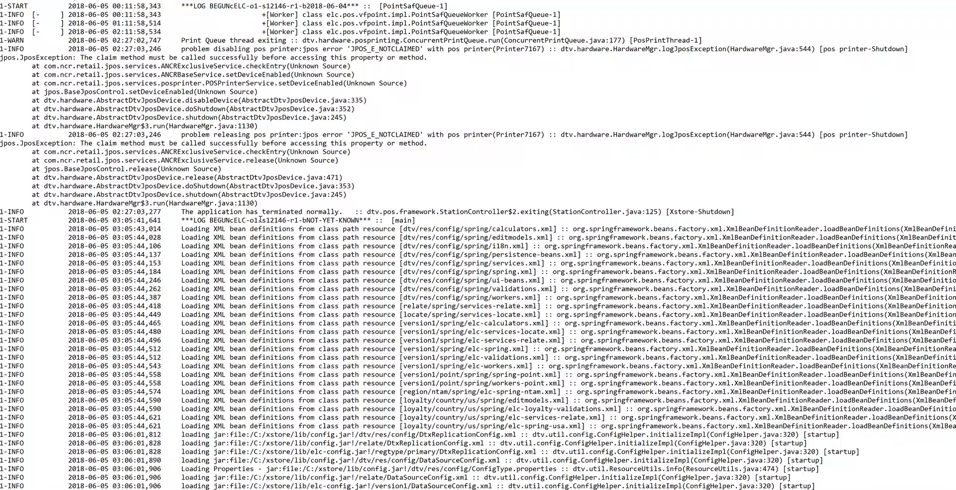
Problem Overview
Oracle Xstore POS provides hardware and software solutions for in-store transactions.
Our registers usually receive thousands of errors everyday from the Xstore, and we mainly rely on our Xstore experts to manually examine the verbose error codes without knowing the root cause.
My goal is to reduce the manual work of examining the error logs.

Slide 4
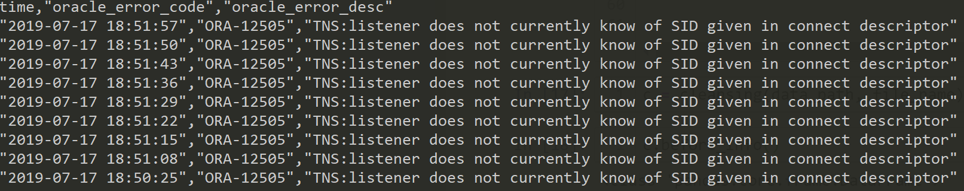
Dataset Overview
10,098,183 errors in total
From November 2018 to July 2019
35 unique error codes

Slide 5
Approaches
Frequency Analysis
Get the top 10 most frequent error codes
Error codes clustering
35 error codes are clustered to 4 different groups
Anomaly Detection
Reduce the errors that need manual examination by 90%.
Observe the periodic patterns in error occurrences

Slide 6
Conclusion & Next steps
If most frequent errors like ORA-12505 and ORA-01033 could be resolved, the errors will be reduced by at least more than 50%.
Errors can be tackled by groups, for example, data base connection(TNS) errors can be resolved together.
If there could be labeled “significant error” events like unusual slow down during Black Friday, the anomaly detection model would be more accurate and would be able to predict “significant error” before it happens.
Data collected by App Dynamics that includes more machine usage data and transaction data would be able to generate more meaningful results. For example, more accurate anomaly detection.

Slide 7



Summer Experience & Future Plan
New York currently ranks at the first on my list of places I want to live at:
Museums,
Volunteer,
Friends,
Talented coworkers

Slide 8
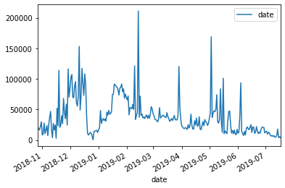
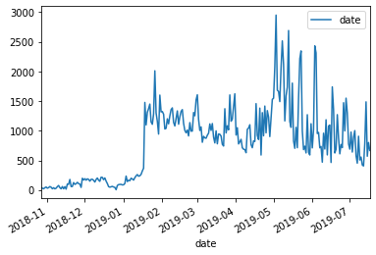
Step 0:Data Cleansing
Error Frequency Histogram
#Occurrences vs Date
Before Cleansing
Results：
212,452 errors in total
Maximum 2950 errors a day
Methods:
Eliminate rows containing N/A entries
Parse the time to date, hour and minute
Drop the duplicates:
Xstore reports errors every few seconds, so that an error often gets to reported numerous times. By dropping the duplicates with the precision of time as minute, the same error occurred in the same minute only count as one occurrence. This can reduce the number of logs without losing the information of the duration of an error.
Tools:
Python Pandas, Numpy
After Cleansing

Slide 9
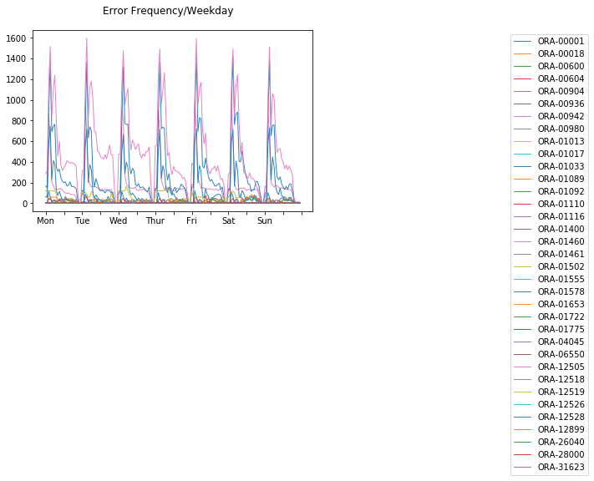
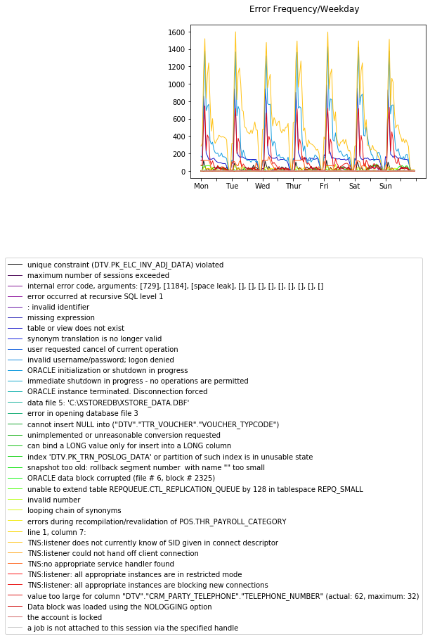
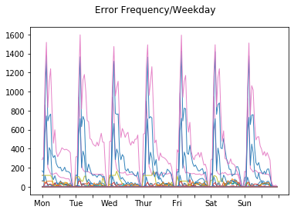
Step 1:Frequency Analysis:

Slide 10
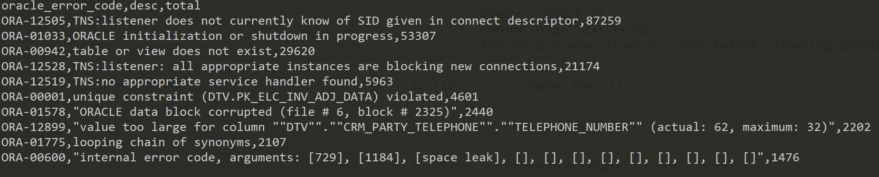
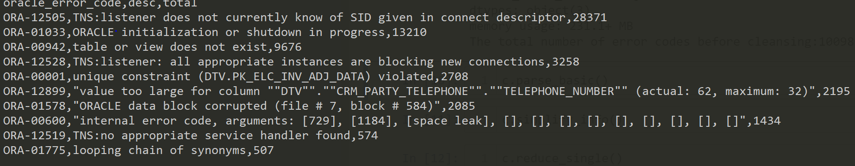
Top 10 most frequent errors:
Most frequent errors All day
Most frequent errors during 10AM-10PM

Slide 11
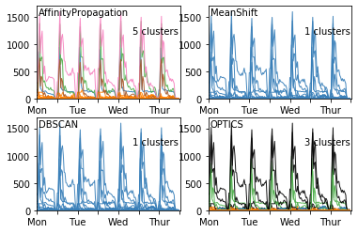
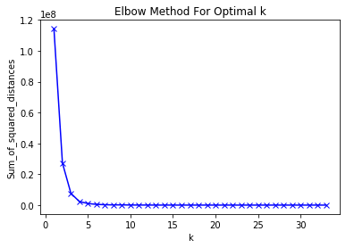
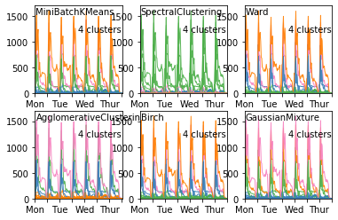
Step 2:Error codes clustering
Methods:
Build a vector t of length 24 * 7 where ti is the number of occurrences of the error at the hour of the week. Ie: t5 means the number of occurrences Monday 5AM – 6AM.
Cluster the error codes based on the Euclidean distance of it’s corresponding
Decide the number of clusters by calculate the sum of mean squared distance
Models：
Centroid-based: KMeans, MeanShift, GMM
Density-based: DBSCAN, OPTICS
Segmentation-based: Spectral clustering
Hierarchical clustering : Affinity Propagation, Agglomerative clustering
Tools：Python Scikit-learn

Slide 12
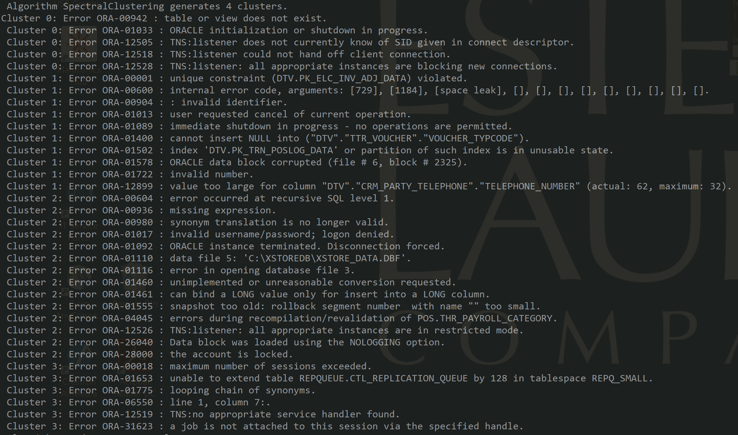
Results
Best model: Spectral Clustering
Evaluation criteria: Similar types of errors were assigned to one cluster from reading Oracle error description.

Slide 13
Step 3:Anomaly Detection
Methods
N-gram and One-class SVM Model adapted from :
Warrender, C., Forrest, S., and Pearlmutter, B. Detecting intrusions using system calls: alternative data methods. In Proc. of IEEE Symposium on Security and Privacy (1999), pp. 133–145.
Results:
A error sample containing 4464 random selected error patterns reduced to 486 error patterns

